Slide 1
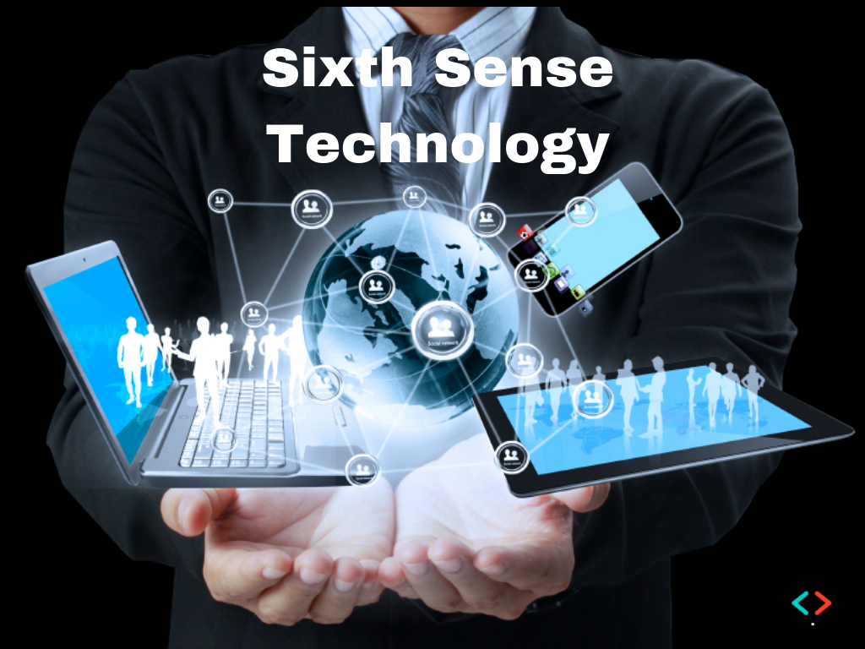
A Presentation on

Slide 2
Introduction
The sixth sense technology allows the user to interact the information through hand gestures.
It is a wearable pendent like device.
Invented by Pranav Mistry during his Phd at Fluid Interfaces Group at the MIT media lab.

Slide 3
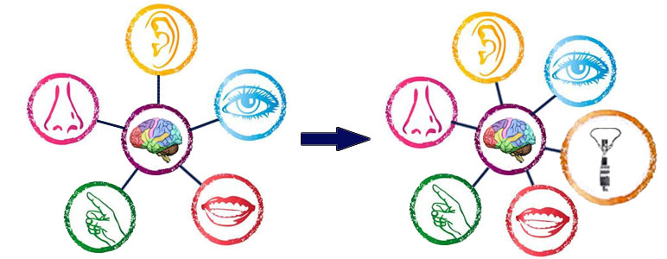
Why sixth sense

Slide 4
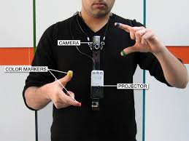
components
Web cam
Smart phone
Mini projector
Color Codes

Slide 5
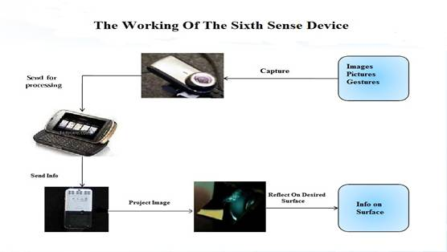
How it works

Slide 6
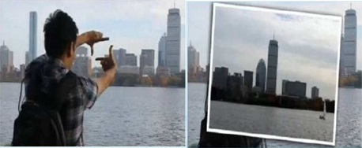
Applications
We can use to capture images

Slide 7
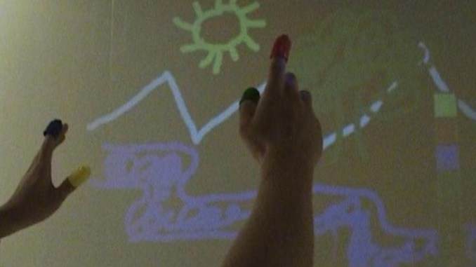
Applications
Used to draw in air

Slide 8
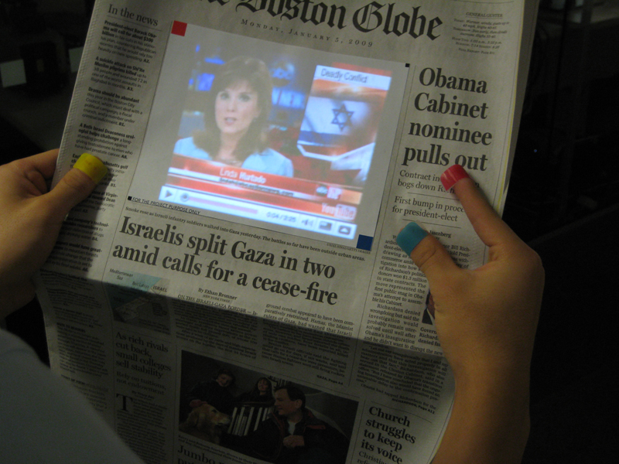
Applications
Used to read news papers like a video

Slide 9
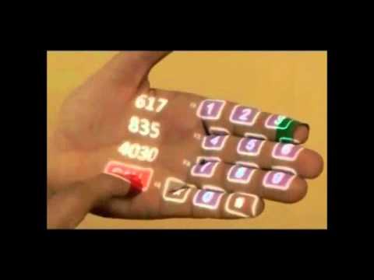
Applications
Used to make phone calls

Slide 10
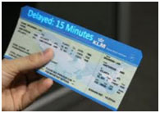
Applications
Used to read the contents of physical objects.

Slide 11
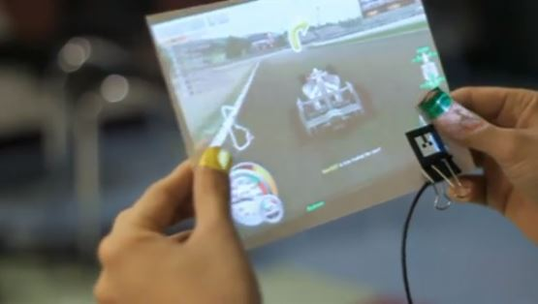
Applications
Used to play games on a paper piece

Slide 12
Advantages
portable
User guide
can be ideal substitute for laptop, tablet, and desktop
scanning a book
used for gaming purpose and also writing accounts

Slide 13
Disadvantages
The hardware limitations are the devices we carry out around with us.
Continuous power supply cannot be supply.
High expensive.
Less privacy.

Slide 14
Future enhancements
Can be enhanced to fifth sense for disabled people
Avoid the color markers.
To have 3d gesture tracking.

Slide 15
Conclusion
This can be used as a replacement of the 5th senses for handicapped peoples. considering its widespread applications the inventor Pranav Mistry has decided to make its software open source. As this technology will emerge may be new devices and hence forth new markets will evolve.

Slide 16
ThanQQQQQQ
Keep smiling

Slide 17
Any queries

